Slide 1
Module 2
Memory Management, Memory Partitioning

Slide 2
Background
Program must be brought into memory and placed within a process for it to be run
Input queue – collection of processes on the disk that are waiting to be brought into memory to run the program
User programs go through several steps before being run

Slide 3
Binding of Instructions and Data to Memory
Address binding of instructions and data to memory addresses can happen at three different stages
Compile time
Load time
Execution time

Slide 4
Logical vs. Physical Address Space
The concept of a logical address space that is bound to a separate physical address space is central to proper memory management
Logical address – generated by the CPU; also referred to as virtual address
Physical address – address seen by the memory unit

Slide 5
Memory-Management Unit (MMU)
Hardware device that maps virtual to physical address
In MMU scheme, the value in the relocation register is added to every address generated by a user process at the time it is sent to memory
The user program deals with logical addresses; it never sees the real physical addresses

Slide 6
Swapping
A process can be swapped temporarily out of memory to a backing store, and then brought back into memory for continued execution
Backing store
Roll out, roll in
Major part of swap time is transfer time; total transfer time is directly proportional to the amount of memory swapped
Modified versions of swapping are found on many systems (i.e., UNIX, Linux, and Windows)

Slide 7
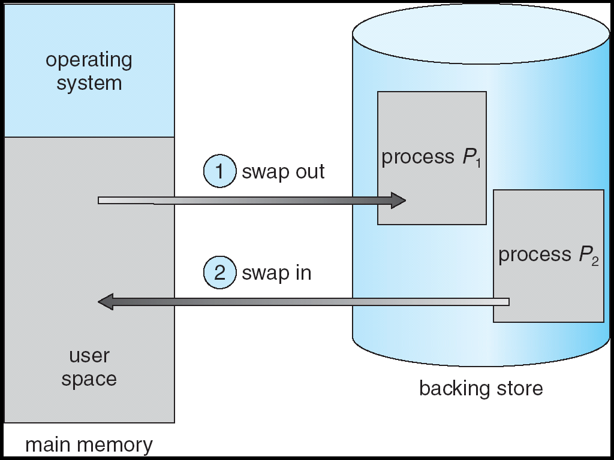
Schematic View of Swapping

Slide 8
Concept of Degree of Multi-programming
The degree of multiprogramming describes the maximum number of processes that a single-processor system can accommodate efficiently
More Process in the RAM
Increases Efficiency

Slide 9
Memory Management Techniques
Contiguous
Non-contiguous
Fixed Partition
Variable Partition
Paging
Inverted Paging
Multi-level Paging
Segmented Paging
Segmentation

Slide 10
Contiguous and Non-contiguous Memory Allocation

Slide 11
Fixed Partitioning/Static Partitioning
Number of partitions are fixed
Size of the partition may or may not be the same
Spanning not allowed
Operating System
Operating System

Slide 12
Fixed Partitioning - Disadvantages
Internal Fragmentation
Limit in Process Size
Degree of Multiprogramming is limited
External Fragmentation
Operating System
Operating System

Slide 13
Variable Partitioning
No internal fragmentation
No limitation on number of processes
No limit on process size
Operating System

Slide 14
Disadvantages
External Fragmentation
Can be avoided by Compaction, but undesirable
Compaction – Time Consuming, Processes has to stop
Allocation and De-allocation is bit complex
As the number of processes are increasing, the holes will also increase
Operating System

Slide 15
Allocation Methods in Contiguous Memory Allocation

Slide 16
Allocation Methods
Operating System
First Fit
Allocate the first hole that is big enough
Next Fit
Same as First Fit but start search always from the last allocated hole
Best Fit
Allocate the smallest hole that is big enough
Worst Fit
Allocate the largest hole

Slide 17
Allocation Methods
Operating System
First Fit
Allocate the first hole that is big enough
Next Fit
Same as First Fit but start search always from the last allocated hole
Best Fit
Allocate the smallest hole that is big enough
Worst Fit
Allocate the largest hole

